Slide 1

Drafting Cave Maps in QGIS
May 4, 2022
Jon Zetterberg

Slide 2
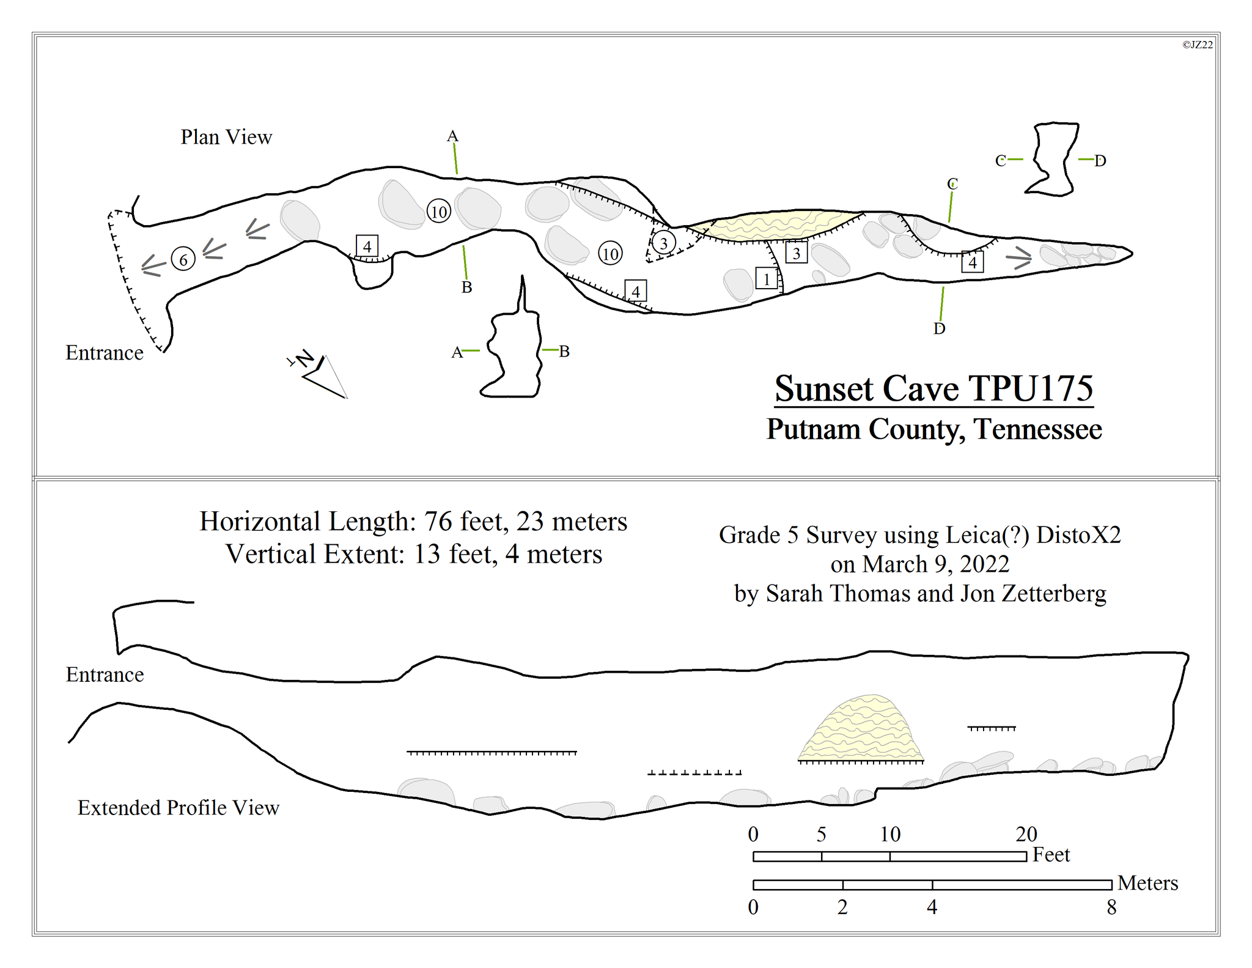
Overview
Why teach Cave Mapping
Why QGIS
Resources and GitHub
Project Setup
Sprint Through

Slide 3
Why Teach Cave Mapping
Recreational Cavers
Survey Helpers
Carto-graphers
Sketchers
Too many caves for me
Interest from others to learn
Too many undrafted cave maps
Lack of resources available

Slide 4


Why QGIS
Cave data is spatial
Mapping software, not a drafting software
Free and Open Source
Well maintained and documented
Runs similarly across multiple platforms
Windows, macOS, Linux, BSD
Mobile and Tablet
Android, iOS, Windows
Notes:
Basic functions do not take a lot of processing power
Mention thesis

Slide 5
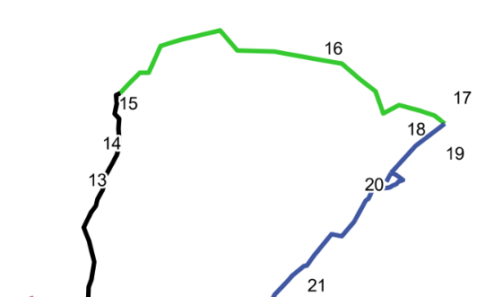
Why QGIS
Generate progress maps after each trip
Generate lead maps
Ease of overlays
Notes:
Basic functions do not take a lot of processing power
Mention thesis

Slide 6
Resources
Online QGIS Documentation
SACS Talks YouTube Channel
Led by Aaron Addison (MO)
Introduction to QGIS for Cavers (46:08)
Georeferencing Cave Maps and Survey Data (1:12:18)

Slide 7

GitHub
CaveMaps_GIS
Database Templates
Symbology Templates
QGIS and ArcGIS

Slide 8
GitHub – Database Templates
Projection Dependent with Three Options
All contain three spatial tables:
 | Coded Value | Type | Level | Rotation | Label | Shown
Point | Integer Value | Specified Text Value | Integer Value | Integer Value | Text Value | True/False
Line | Integer Value | Specified Text Value | Integer Value | - | Text Value | True/False
Polygon | Integer Value | Specified Text Value | Integer Value | - | - | True/False

Slide 9
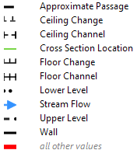
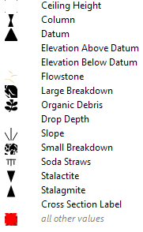
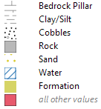
GitHub - Symbology Templates
Lines Points Polygons

Slide 10
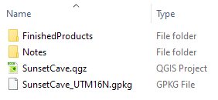
Project Setup - Folder Structure
Sunset Cave
FinishedProducts (Folder)
ProgressMaps (Folder)
Notes (Folder)
SurveyData (Folder per survey date)
Notes.txt (Text file for general notes)
[Compass file(s) or similar]
SunsetCave.qgz (QGIS project file)
SunsetCave_UTM16N.gpkg (Geopackage to store GIS data)

Slide 11
Project Setup - QGIS
Turn on Toolbars (View -> Toolbars)
Advanced Digitizing
Snapping Toolbar

Slide 12
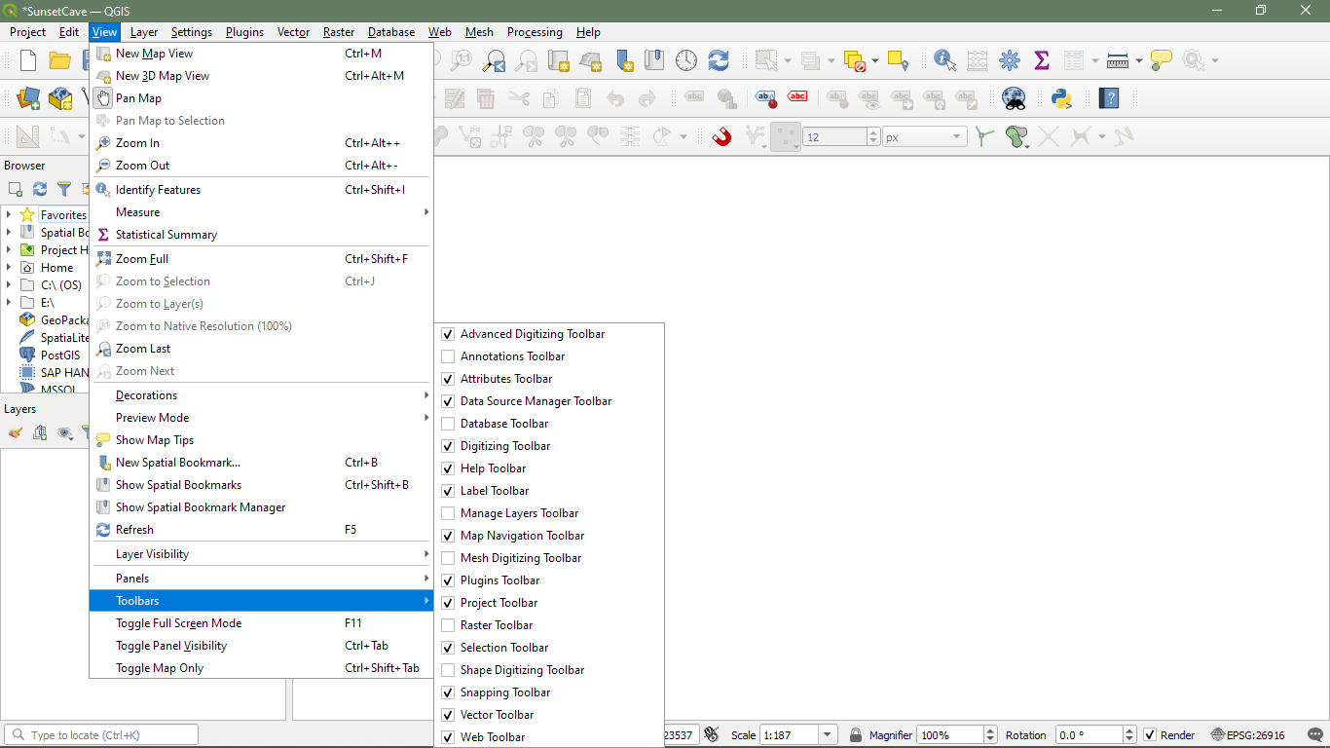

Slide 13
Project Setup - QGIS
Turn on Toolbars (View -> Toolbars)
Advanced Digitizing
Snapping Toolbar
Set CRS (Project -> Properties, CRS Tab)
Coordinate Reference System
Name | Base Unit | EPSG Code
TN State Plane NAD83(2011) | Foot | 6576
UTM16 NAD83 | Meter | 26916
UTM17 NAD83 | Meter | 26917

Slide 14
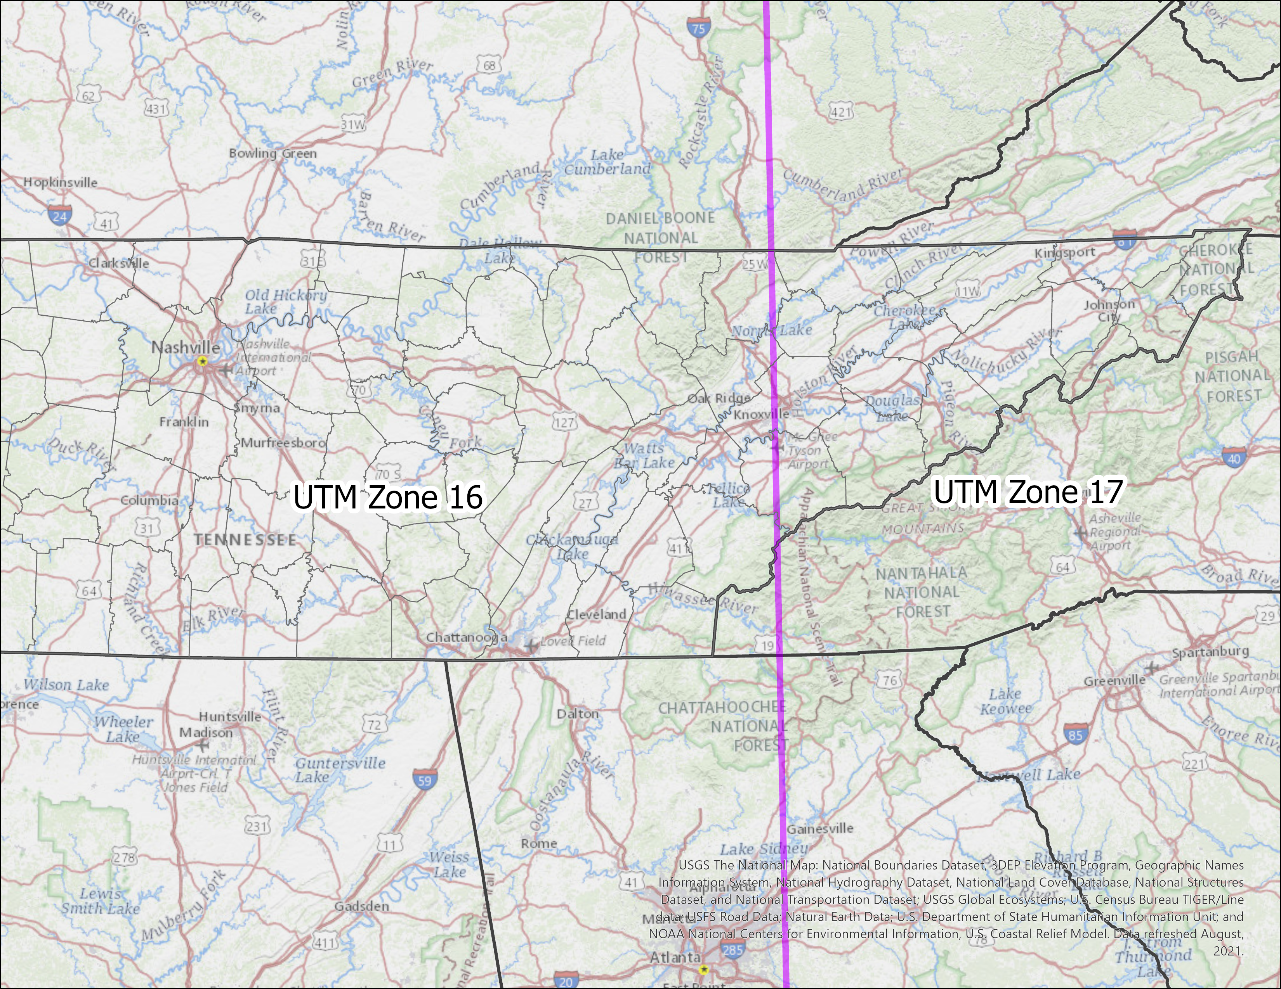

Slide 15
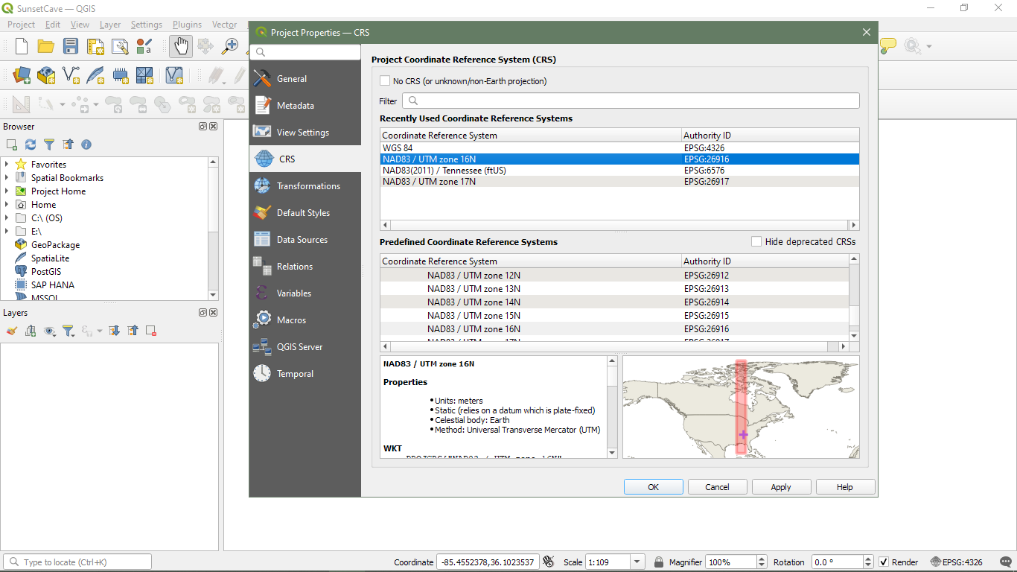

Slide 16
Project Setup - QGIS
Add Survey Data (Drag and Drop from Folder)

Slide 17
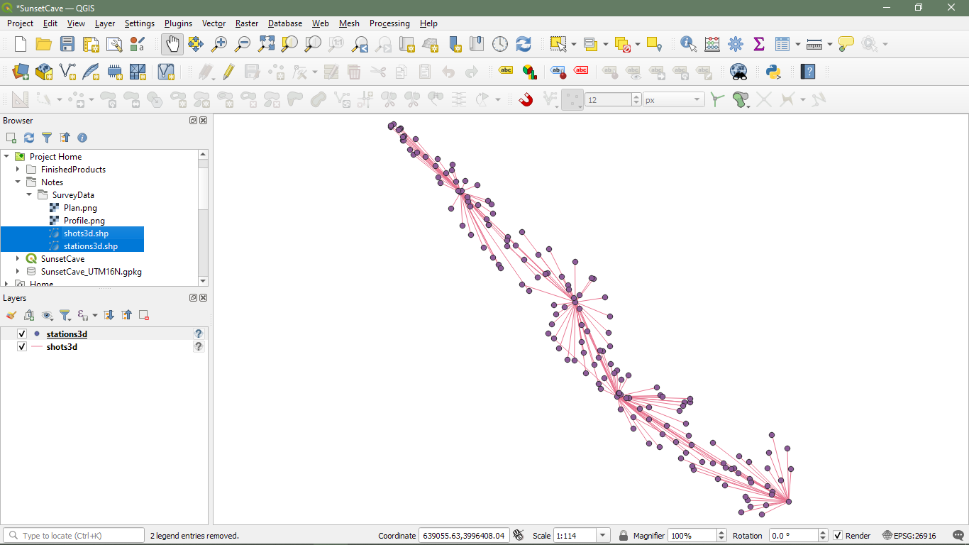

Slide 18
Project Setup - QGIS
Add Survey Data (Drag and Drop from Folder)
Label Survey Stations (Layer Properties, Labels Tab)

Slide 19
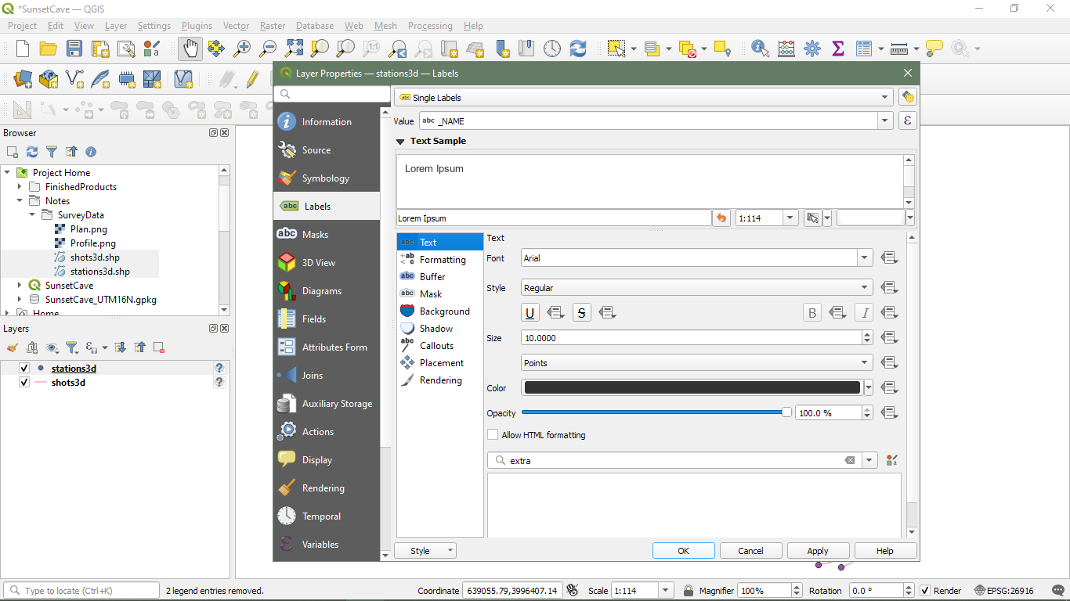

Slide 20
Project Setup - QGIS
Add Survey Data (Drag and Drop from Folder)
Verify in correct location (Add basemap)
Label Survey Stations (Layer Properties, Labels Tab)
Group Data (Select both layers, Right click, Group Selected)

Slide 21
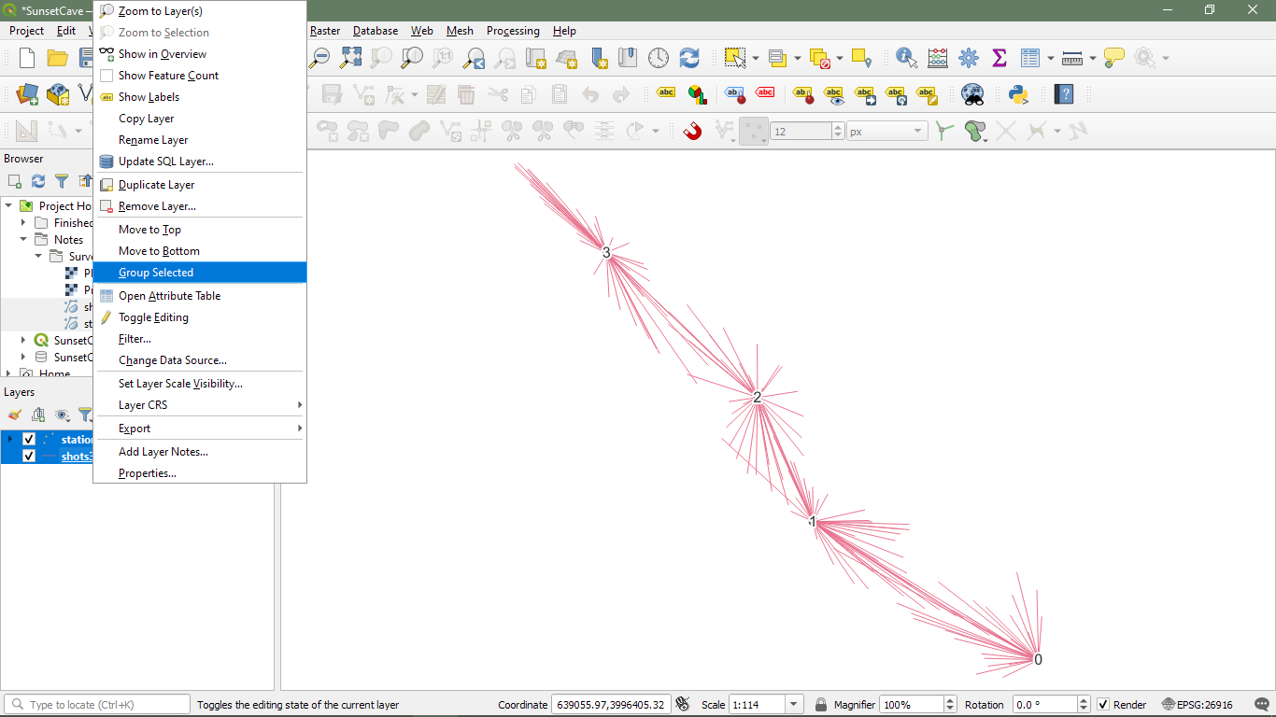

Slide 22
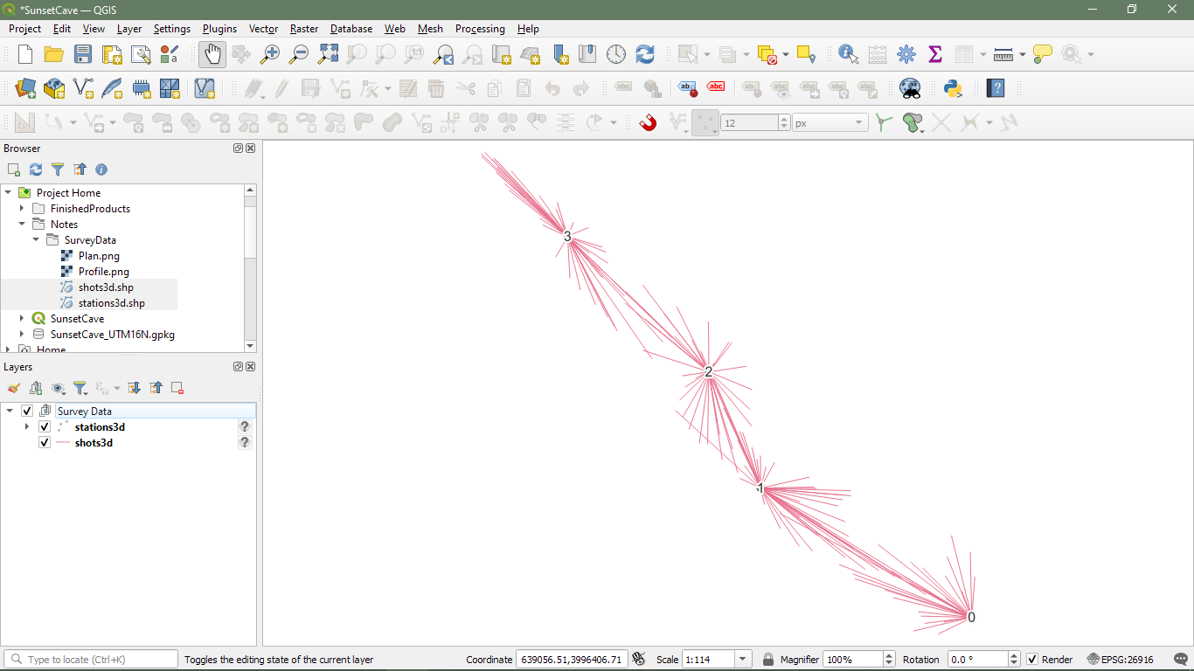

Slide 23
Project Setup - QGIS
Add Survey Data (Drag and Drop from Folder)
Verify in correct location (Add basemap)
Label Survey Stations (Layer Properties, Labels Tab)
Group Data (Select both layers, Right click, Group Selected)
Add Cave Features from Template
Group Data
Load Symbology Style (Layer Properties, Symbology Tab, Style)
Repeat for Lines, Points, and Polygons

Slide 24
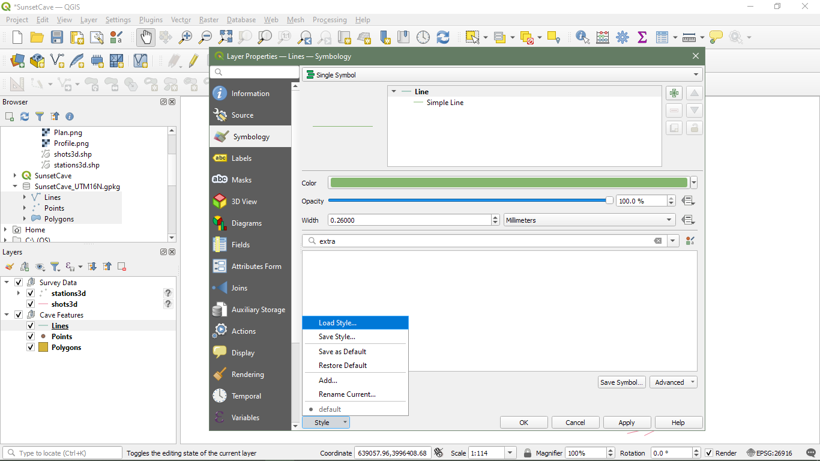

Slide 25
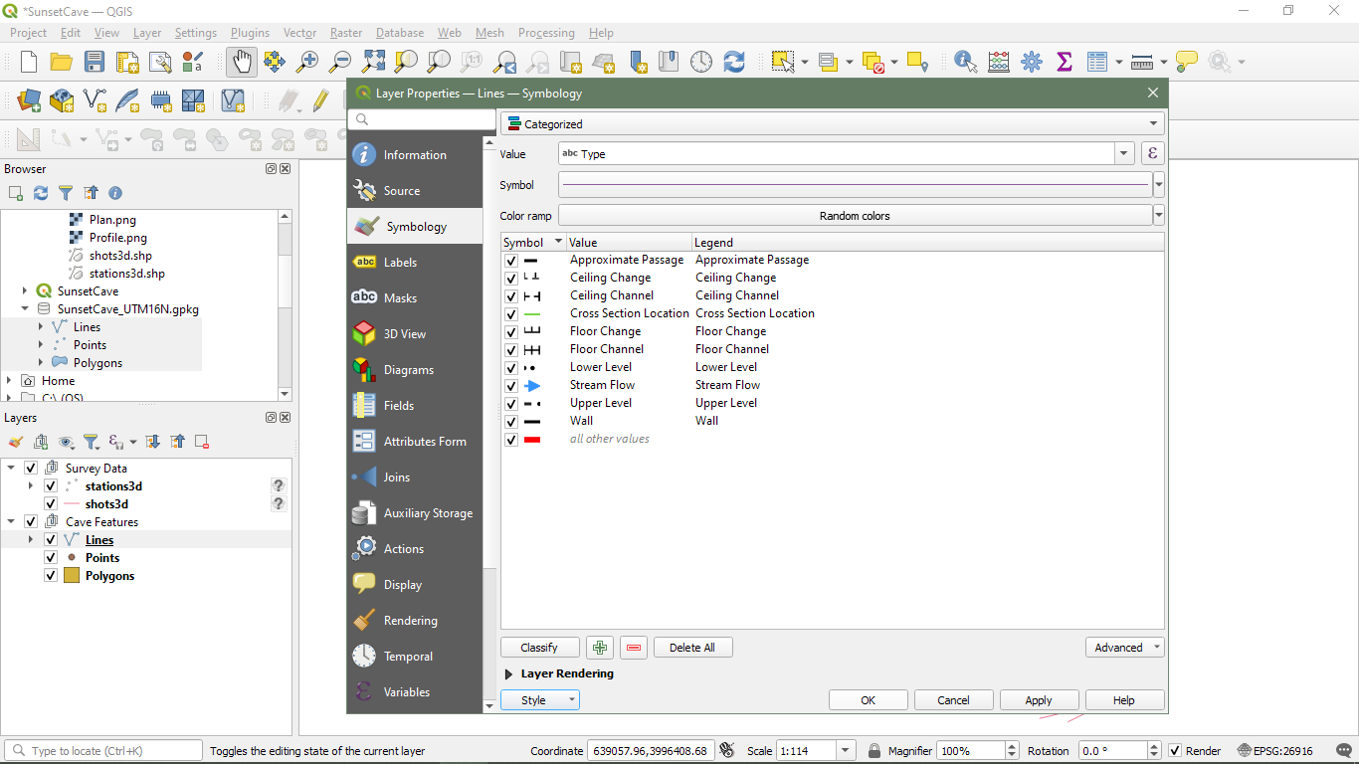

Slide 26
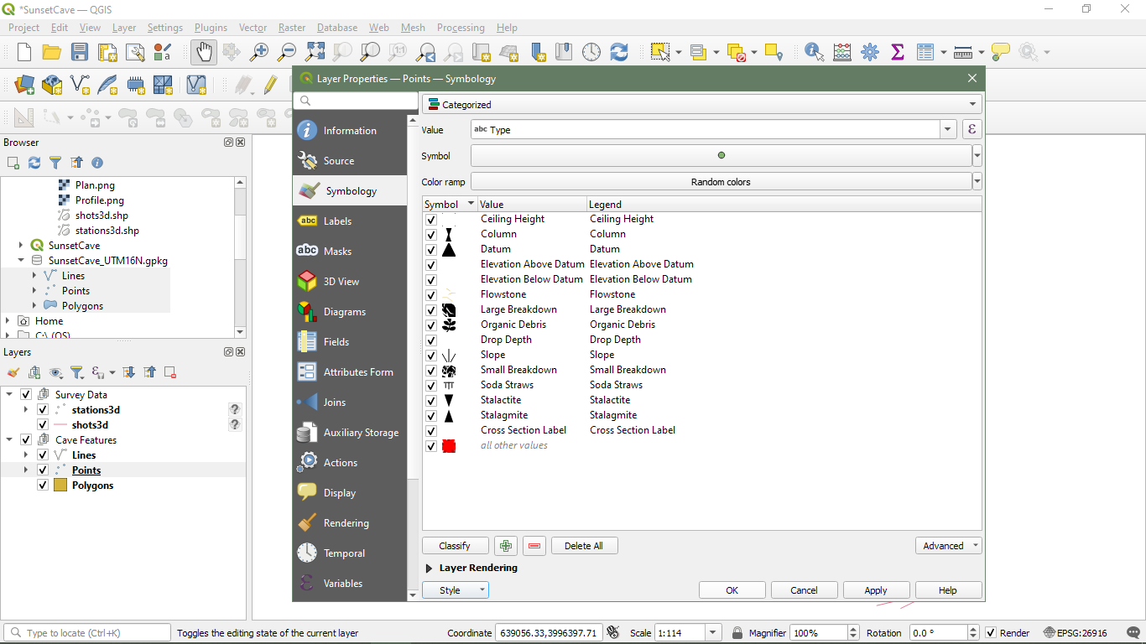

Slide 27
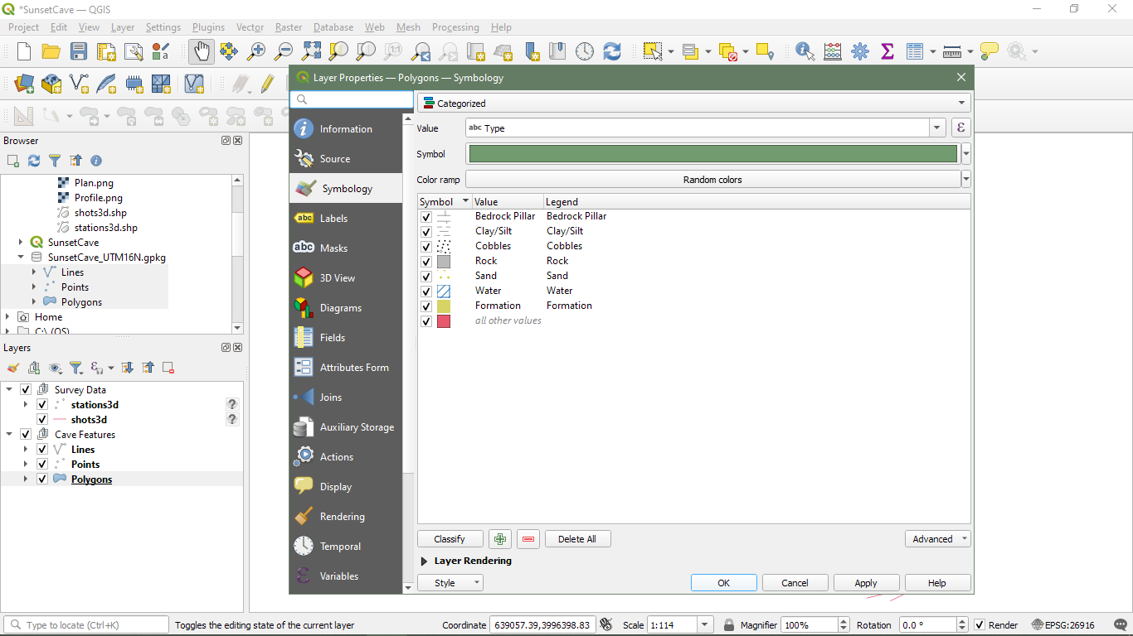

Slide 28
Sprint Through
Georeference Sketches to Survey Data
Digitize Sketches
Produce Final Map Layout
Add Additional Information
Package Data for Archiving
Attribute Digitized Features
Set Map Scale and Adjust Features as Needed

Slide 29
Sprint Through – Sunset Cave TPU175
Simple and Convenient
Hartselle-Monteagle Cave outside of Cookeville
Friendly Landowner
“The entrance is 5 feet wide and 5 feet high. It slopes down into a walking passage, 12 feet high. This continues at the same level for 80 feet to the end. No leads. Dry cave. (Ray C. Lewis III, 1975; Gerald Moni, 2010)”
Notes:
European Petroleum Survey Group

Slide 30
Georeference
Sketches must be image file (tif, png, jpg…)
SACS Talks Video explains process well
Raster -> Georeferencer
Notes:
European Petroleum Survey Group

Slide 31
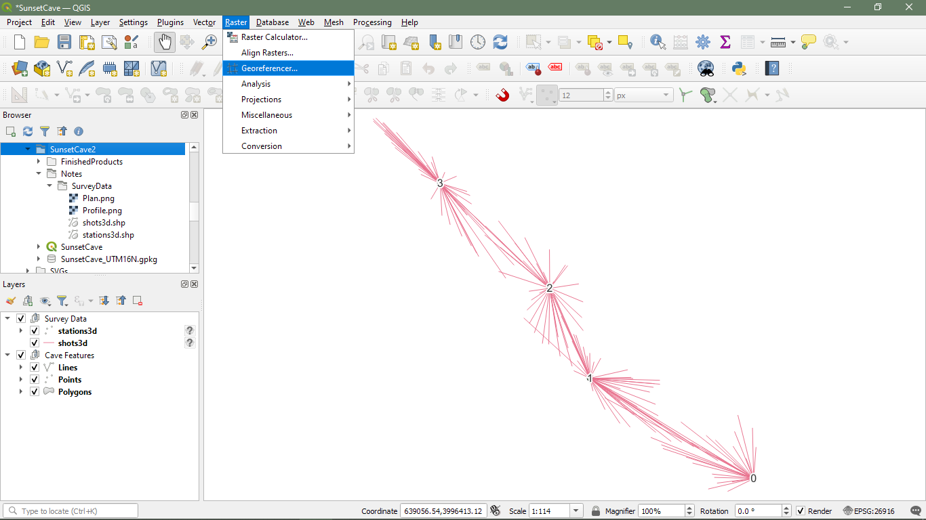

Slide 32
Georeference
Sketches must be image file (tif, png, jpg…)
SACS Talks Video explains process well
Raster -> Georeferencer
Add Points for each Survey Station on Sketch and match to Survey Station on Map Canvas
The more points which are used, the more accurate the georeferencing will be
Notes:
European Petroleum Survey Group

Slide 33
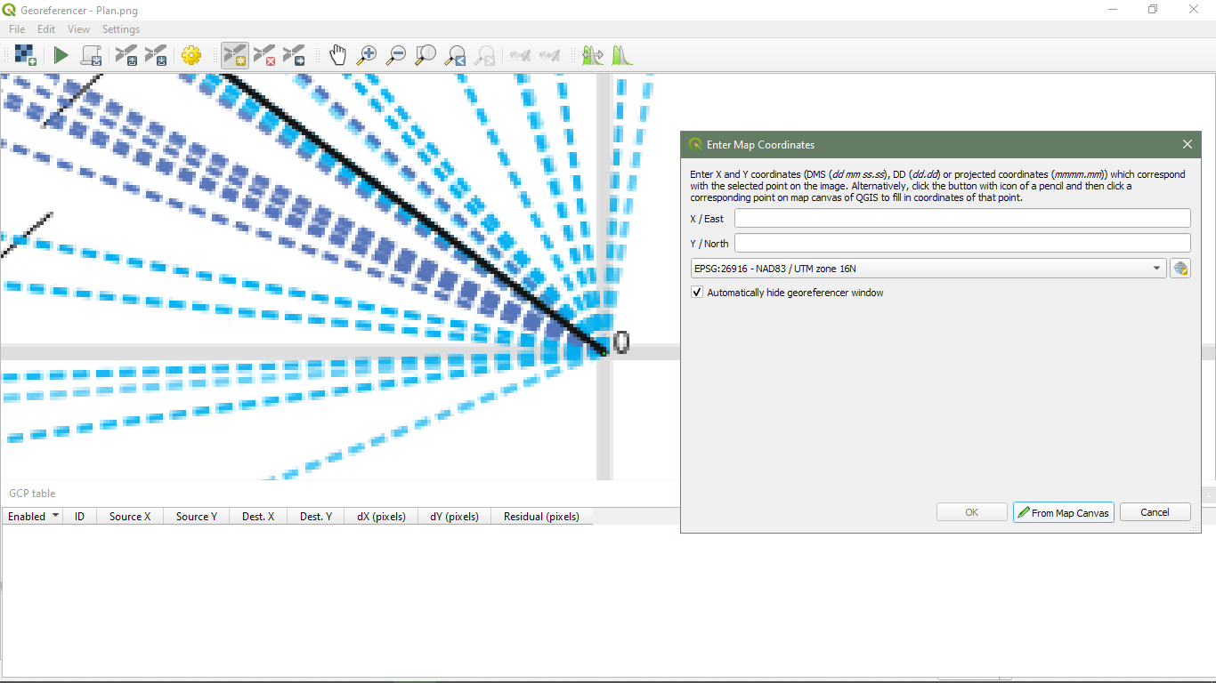

Slide 34
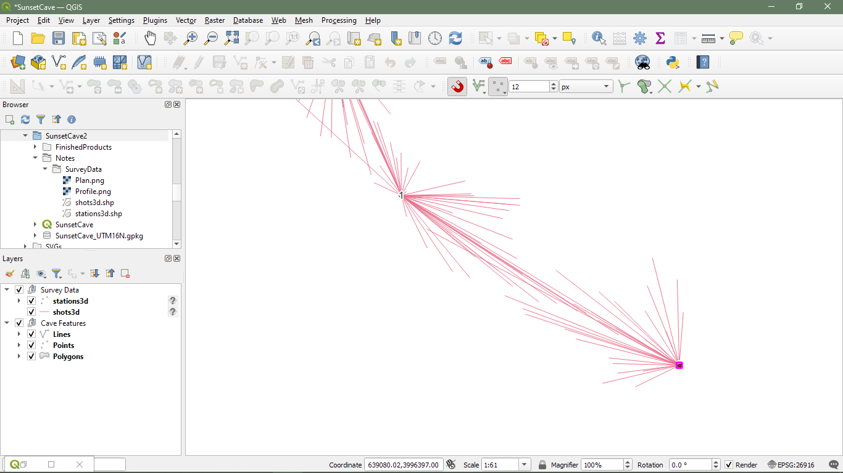

Slide 35
Georeference
Sketches must be image file (tif, png, jpg…)
SACS Talks Video explains process well
Raster -> Georeferencer
Add Points for each Survey Station on Sketch and match to Survey Station on Map Canvas
The more points which are used, the more accurate the georeferencing will be
Within the Transformation Settings, choose a Transformation Type and set the Output Raster
Notes:
European Petroleum Survey Group

Slide 36
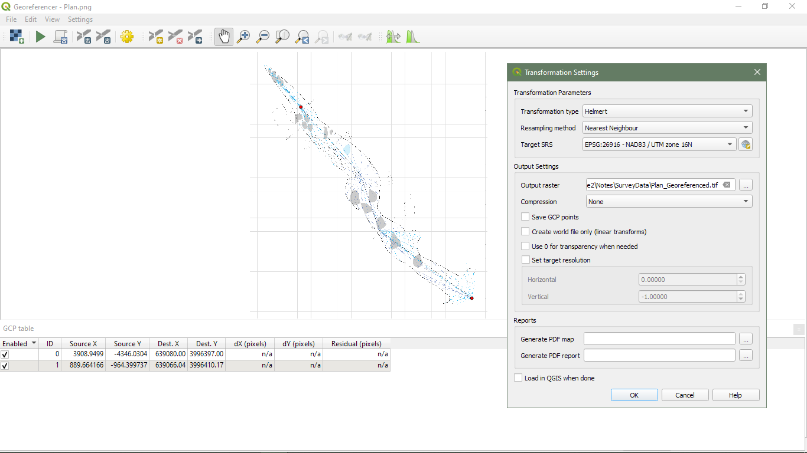

Slide 37
Georeference
Sketches must be image file (tif, png, jpg…)
SACS Talks Video explains process well
Raster -> Georeferencer
Add Points for each Survey Station on Sketch and match to Survey Station on Map Canvas
The more points which are used, the more accurate the georeferencing will be
Within the Transformation Settings, choose a Transformation Type and set the Output Raster
Start Georeferencing, add to Map Canvas
Notes:
European Petroleum Survey Group

Slide 38
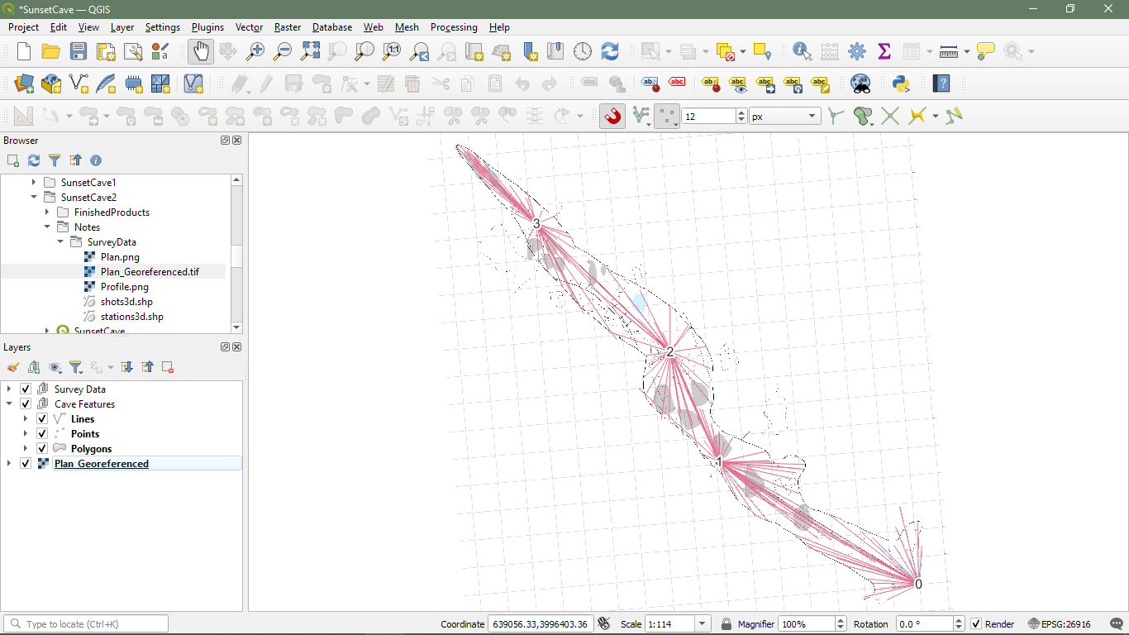

Slide 39
Notes:
European Petroleum Survey Group

Slide 40
Notes:
European Petroleum Survey Group

Slide 41
Notes:
European Petroleum Survey Group

Slide 42
Notes:
European Petroleum Survey Group

Slide 43
Notes:
European Petroleum Survey Group

Slide 44
Notes:
European Petroleum Survey Group

Slide 45
Questions
NSS67484
jzett33@gmail.com

